Slide 1
DS3202: PARALLEL PROGRAMMING
MODULE – 3
Advanced OpenMP
6th SEM
B.Tech
DSE

Slide 2
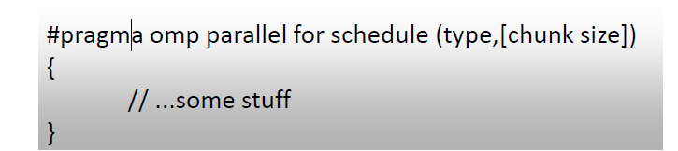
Advanced OpenMP Constructs
Schedule clause
Specifies how loop iteration are divided among team of threads.
Schedule refers to the way in which loop indices are distributed among threads
The default schedule is implementation dependent.
Supported scheduling types are:
Static
Dynamic
Guided
Runtime
Auto

Slide 3
Why Schedule Clause?
A parallel region has at least one barrier, at its end, and may have additional barriers within it.
At each barrier, the other members of the team must wait for the last thread to arrive.
To minimize this wait time, shared work should be distributed so that all threads arrive at the barrier at about the same time.
If some of that shared work is contained in for constructs, the schedule clause can be used for this purpose.

Slide 4
Static Clause
Default is static
Loop iterations are divided into pieces of size chunk and then statically assigned to threads.
Chunk is a contiguous group of iterations within a loop that are assigned to a single thread to execute simultaneously in parallel processing.
The chunk size specifies how many iterations should be included in each chunk assigned to a thread.
If chunk is not specified, the iteration are evenly (if possible) divided contiguously among the threads.
The size of a chunk, denoted as chunk_size, must be a positive integer.
Each thread is assigned a contiguous range of indices in order of thread number called round robin and is known as block cyclic scheduling
Number of indices assigned to each thread is as equal as possible

Slide 5
Syntax
#pragma omp parallel for schedule (static,[n])
{
// ...some stuff
}

Slide 6
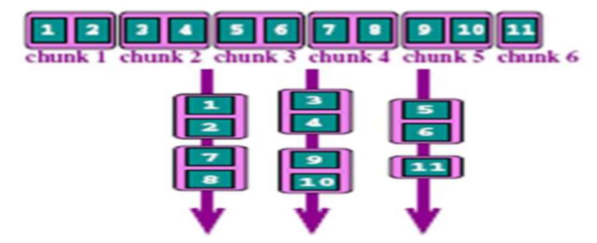

Slide 7
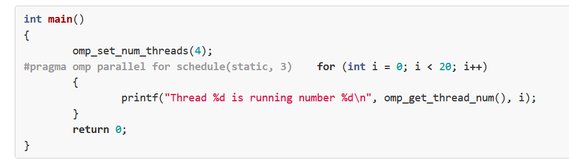
Example

Slide 8
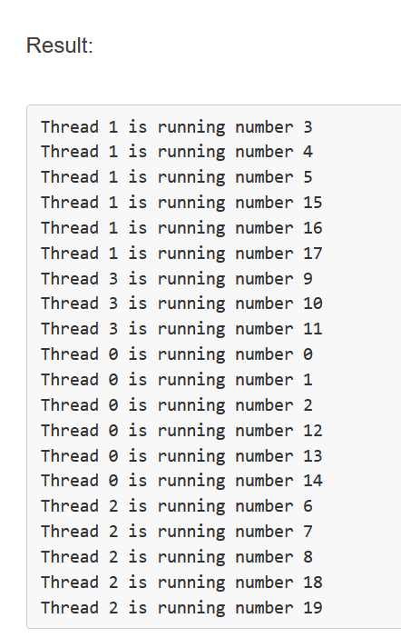

Slide 9
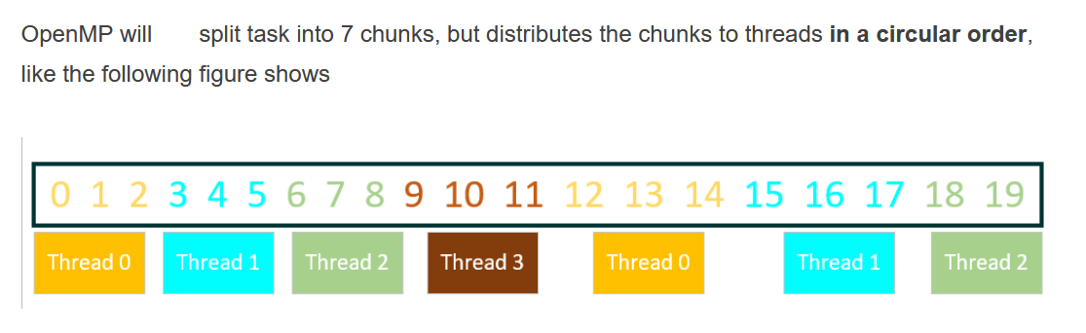

Slide 10
Dynamic Clause
Loop iterations are divided into chunks containing n iterations each and then dynamically assigned to threads.
When a thread finishes one chunk, it is dynamically assigned another.
The default chunk size is 1.
Iterations picked by threads depends upon the relative speeds of thread execution
#pragma omp parallel for schedule(dynamic, 1) is equivalent to
#pragma omp parallel for schedule(dynamic)
#pragma omp parallel for schedule (dynamic, chunk_size)
for(i=0; i<8; i++)
{
… (loop body)
}

Slide 12
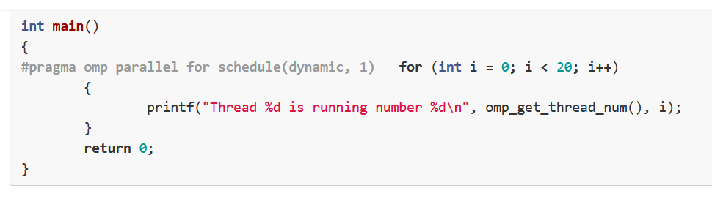
Example

Slide 13
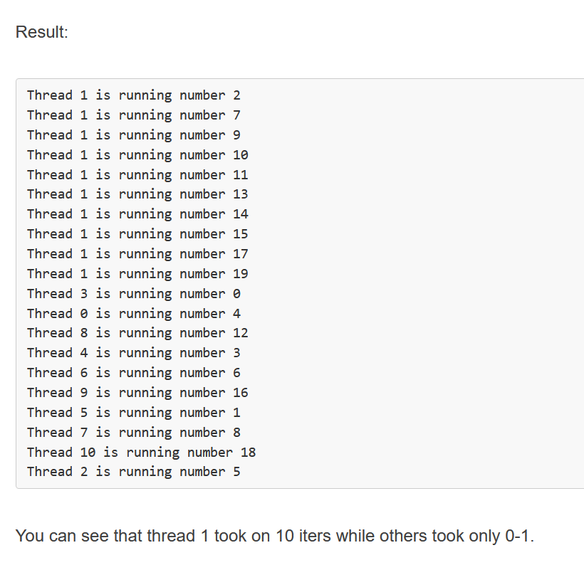

Slide 14
Guided Clause
Chunk size is dynamic while using guided method
The size of a chunk is proportional to the number of unassigned iterations divided by the number of the threads, and the size will be decreased to chunk-size (but the last chunk could be smaller than chunk-size)
chunk size = max((num_of_iterations remaining / 2*num_of_threads), n)
The formula may differ across compiler implementations
If you specify n, that is the minimum chunk size that each thread should get.
Size of each successive chunks is decreasing
The default chunk size is 1.
#pragma omp parallel for schedule (guided, chunk_size)
for(i=0; i<8; i++)
{
… (loop body)
}

Slide 15
The guided schedule is appropriate for the case in which the threads may arrive at varying times at a for construct with each iteration requiring about the same amount of work.
This situation can happen if, for example, the for construct is preceded by one or more sections or for constructs with nowait clauses.

Slide 16
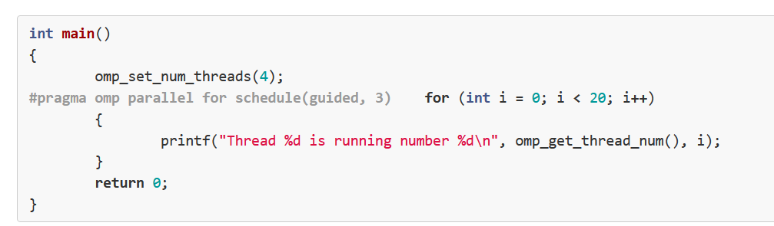
Example

Slide 17
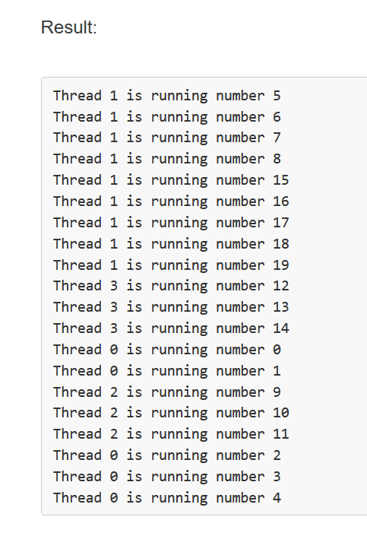

Slide 18
Runtime Clause
Determine the scheduling type at run time by the OMP_SCHEDULE environment variable
export OMP_SCHEDULE=“static, 4”
Schedule can be specified through omp_schedule environment variable
The schedule(runtime) clause tells it to set the schedule using the environment variable
The scheduling decision is deferred until runtime by the environment variable OMP_SCHEDULE.
It is illegal to specify a chunk size for this clause
#pragma omp for schedule(runtime)
for(i=0; i<8; i++)
{
… (loop body)
}

Slide 19
Auto Clause
With auto, scheduling is delegated to the compiler and runtime system.
The compiler and runtime system can choose any possible mapping of iterations to threads (including all possible valid schedules) and these may be different in different loops.
That is delegates the decision of the scheduling to the compiler and/or runtime system.
Thus, scheduling will be decided automatically by your machine.
#pragma omp parallel for schedule (auto)
for(i=0; i<8; i++)
{
… (loop body)
}

Slide 20
Flush Directive
Flush operation does not actually synchronize different threads.
It just ensures that the thread’s values are made consistent with main memory.
Flush forces data to be updated in memory so that other threads see the most recent value.
Thread-visible variables are written back to memory at this point.
It prevents threads from observing stale or outdated values of variables.
For pointers in the list, note that the pointer itself is flushed, not the object it points to.

Slide 21
However, processors can have their own registers and cache.
–If a thread updates shared data, the new value will first be saved in register and then stored back to the local cache.
–The update are thus not necessarily immediately visible to other threads.

Slide 22
Usage of flush directive
The flush directive is typically used in conjunction with shared variables that are accessed by multiple threads within a parallel region.
Placed before a memory read operation to ensure that the most recent values of shared variables are observed.
Placed after a memory write operation to ensure that the updated values are visible to other threads.
Syntax : #pragma omp flush(list)
where list is a comma-separated list of variables whose updates need to be synchronized across threads.
The list contains a list of named variables that will be flushed in order to avoid flushing all variables.

Slide 23
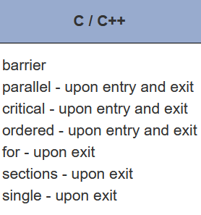
The FLUSH directive is implied for the directives shown in the table below.
The directive is not implied if a NOWAIT clause is present.

Slide 24
Memory ordering using flush directive
The flush directive imposes a memory ordering constraint on the execution of the program, ensuring that updates to variables are propagated in the specified order.
Prevents reordering of memory operations by the compiler or hardware, which could lead to incorrect program behavior.

Slide 25
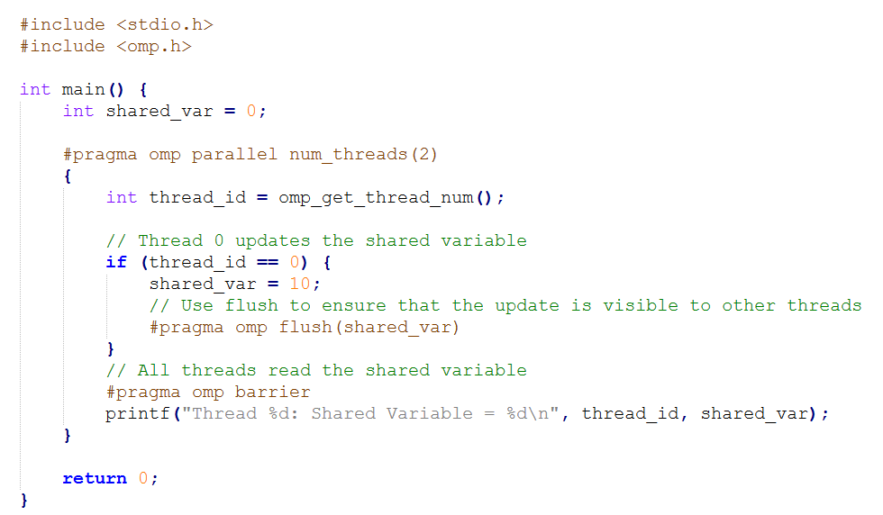
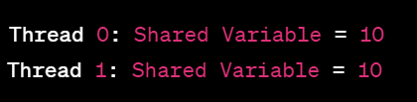
Example Code-Flush Directive

Slide 26
Explanation of code
In this code, we have a shared variable shared_var. Thread 0 updates the shared variable to the value 10.
We use the flush directive after updating shared_var to ensure that the update is visible to other threads.
All threads then wait at the barrier (#pragma omp barrier) to ensure that the update is visible before proceeding.
Thread 0 updates the shared variable shared_var to the value 10 and flushes the update. Both threads then wait at the barrier.
Once the barrier is reached and the update is visible to all threads, both threads print the value of the shared variable, which is 10 in this case.

Slide 27
Nested Parallelism
OpenMP parallel regions can be nested inside each other.
That means the ability to create parallel regions within other parallel regions.
Nested parallelism enables a hierarchical structure of parallelism.
Nested parallelism can potentially improve the utilization of computing resources.
You need to turn on nested parallelism by setting OMP_NESTED or omp_set_nested because many implementations turn off this feature by default.
If nested parallelism is disabled, then the new team created by a thread encountering a parallel construct inside a parallel region consists only of the encountering thread.
If nested parallelism is enabled, then the new team may consist of more than one thread.

Slide 28
Creation of nested parallel regions
Nested parallel regions are created by encountering additional parallel constructs (#pragma omp parallel) within an existing parallel region.
When a thread encounters a nested parallel construct, it creates a team of threads to execute the nested parallel region.
The number of threads created for the nested parallel region may be determined by the num_threads clause or the environment settings.
Nested parallelism uses the concept of spawning. It refers to the action of creating a new, independent thread that can run concurrently with the original thread.

Slide 29
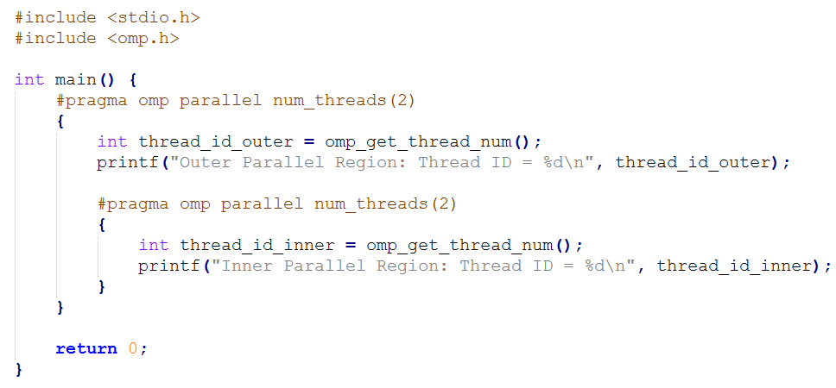
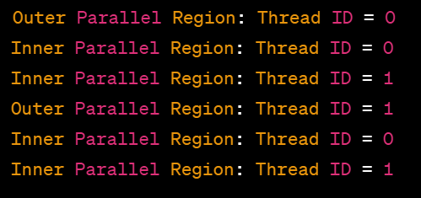
Example code 1– Nested Parallelism

Slide 30
Explanation of Code
Each thread in the outer parallel region will print its thread ID.
Then, each thread in the outer parallel region will enter the inner parallel region.
Within the inner parallel region, each thread will print its thread ID again.
This demonstrates that each thread in the outer parallel region can spawn threads to execute the inner parallel region.

Slide 31
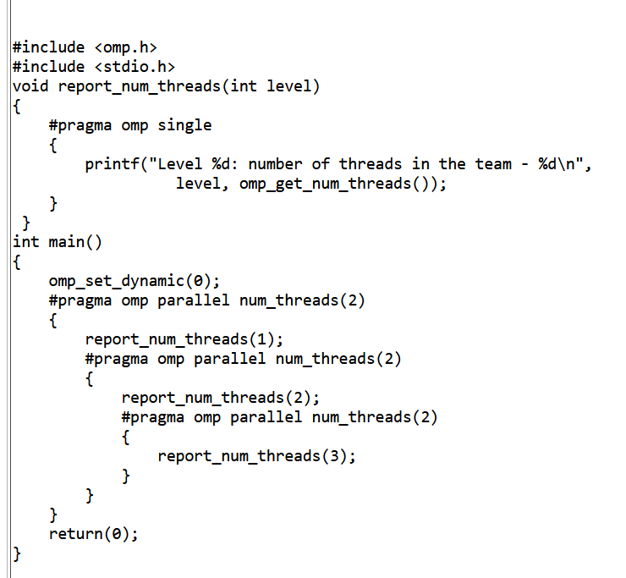
Example 2

Slide 32
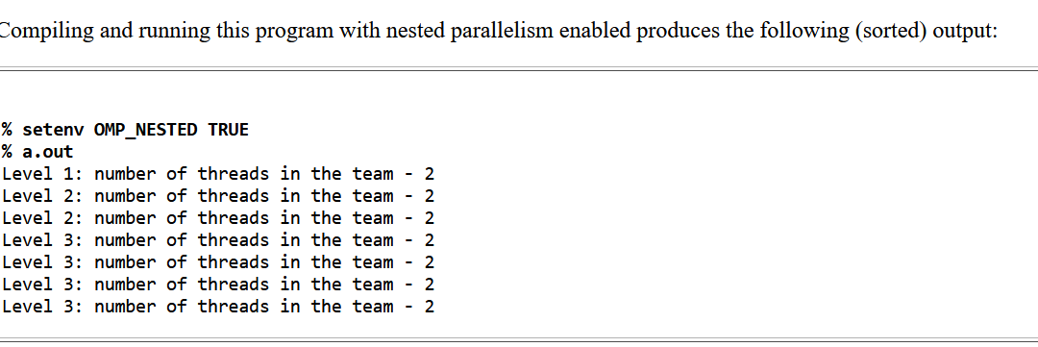

Slide 33
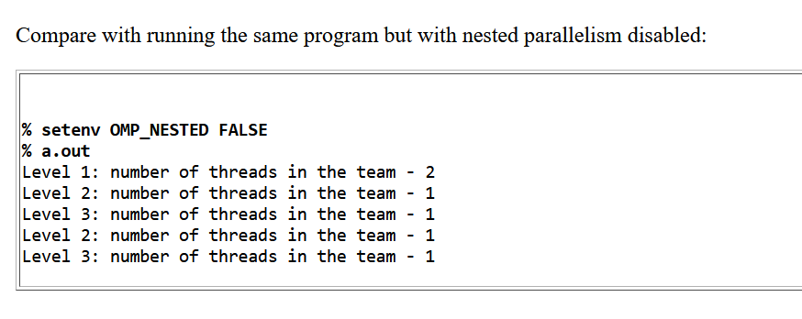

Slide 34
Explanation
Nested parallelism disabled → Inner #pragma omp parallel does not create new threads; only the encountering thread runs it sequentially.
Nested parallelism enabled → Each thread in the outer region can create a full new team in the inner region.
omp_get_num_threads -> returns the number of threads currently active within the parallel region where it is called.

Slide 35
Performance Considerations in Nested Parallelism
Nested parallelism allows for more granular control over thread allocation and resource utilization.
The threads from outer parallel regions can be reused or allocated to execute inner parallel regions.
While nested parallelism can potentially improve performance by exploiting additional parallelism, it can also introduce overhead due to thread management and synchronization.
Excessive nesting may lead to diminishing returns or increased overhead.

Slide 36
Thread private directive
Used to declare variables that should have private instances for each thread in a parallel region.
Variables declared with the "thread private" directive have private instances for each thread in a parallel region.
Syntax : #pragma omp threadprivate(variable_list)
where variable_list is a comma-separated list of variables that should have private instances for each thread.

Slide 37
Scope and initialization
Scope :
The "thread private" directive typically appears outside of parallel regions, often at the global or file scope.
Specifies that the listed variables should be treated as thread-private for all subsequent parallel regions.
Initialization :
Thread-private variables are initialized once at the beginning of the program execution.
The initial values are shared across all threads but are independent of the initial values of variables in other threads.

Slide 38
Usage and memory overhead
Usage : Commonly used for global variables or variables declared at file scope that need to be shared across multiple parallel regions but have private instances for each thread.
Memory Overhead :
Using the "thread private" directive incurs memory overhead, as each thread maintains its own private copy of the variable.
Hence, it should be used judiciously, especially for large variables or in scenarios with a large number of threads.

Slide 39

Example code of thread private
#include <stdio.h>
#include <omp.h>
#pragma omp threadprivate(global_var)
int global_var = 0;
int main() {
// Parallel region with two threads
#pragma omp parallel num_threads(2)
{
// Assign global_var within the parallel region
global_var = omp_get_thread_num();
// Each thread prints its own thread-private value of the global variable
printf("Thread %d: Global Variable = %d\n", omp_get_thread_num(), global_var);
}
return 0;
}

Slide 40
Code explanation
The global variable global_var is marked as threadprivate, so each thread has its own private instance of this variable.
Before entering the parallel region, the main thread sets the value of global_var to its 0.
Within the parallel region, there are two threads.
Thread 0 prints its own private instance of global_var, which retains the value set outside the parallel region (0).
Thread 1 also prints its own private instance of global_var, ie (1).

Slide 41
Example 2
#include <stdio.h>
#include <omp.h>
int a, b, i, tid;
float x;
// Declare a and x as thread-private variables
#pragma omp threadprivate(a, x)
int main() {
/* Explicitly turn off dynamic threads */
omp_set_dynamic(0);
printf("1st Parallel Region:\n");
#pragma omp parallel private(b, tid)
{
tid = omp_get_thread_num();
a = tid;
b = tid;
x = 1.1 * tid + 1.0;
printf("Thread %d: a = %d, b = %d, x = %f\n", tid, a, b, x);
} /* End of 1st parallel region */

Slide 42
Example 2
printf("************************************\n");
printf("Master thread doing serial work here\n");
printf("************************************\n");
printf("2nd Parallel Region:\n");
#pragma omp parallel private(tid) firstprivate(b)
{
tid = omp_get_thread_num();
printf("Thread %d: a = %d, b = %d, x = %f\n", tid, a, b, x);
} /* End of 2nd parallel region */
return 0;

Slide 43
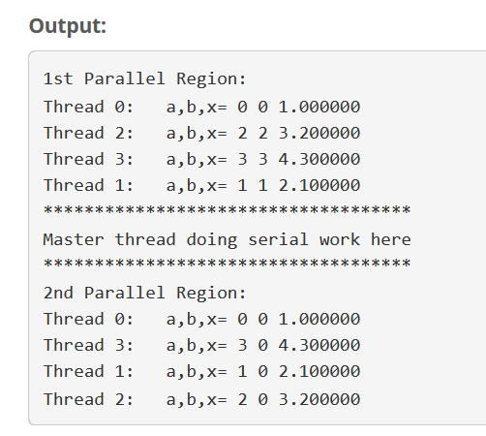

Slide 44
Data in THREADPRIVATE objects is guaranteed to persist only if the dynamic threads mechanism is “turned off” and the number of threads in different parallel regions remains constant. The default setting of dynamic threads is undefined.
The THREADPRIVATE directive must appear after every declaration of a thread private variable/common block.

Slide 45
Difference between private and thread private
Scope :
The "thread private" directive is typically used at the global or file scope and specifies that the listed variables should have private instances for each thread in all subsequent parallel regions.
The "private" data scope attribute clause is used within parallel constructs (e.g., parallel, for, sections) to declare private variables and applies only within the specific parallel region where it is used and affects only that region.
Usage :
Thread private directive is used for variables that need to be shared across multiple parallel regions but have private instances for each thread.
Private data scope attribute clause is used to declare private variables within a specific parallel region.

Slide 46
Continued………
Initialization :
Variables declared with the "thread private" directive are initialized once at the beginning of the program execution.
Private variables declared within a parallel region are typically uninitialized at the start of the region and may retain their previous values if they have been used in an outer scope.
Memory overhead :
Thread private directive Incurs memory overhead as each thread maintains its own private copy of the variable.
Private variables declared within a parallel region do not incur memory overhead outside of that region.

Slide 47
End of Module 3
(THANK YOU)

